Slide 1
What’s The Big Deal About Israel?
Genesis 12:1-3

Slide 2
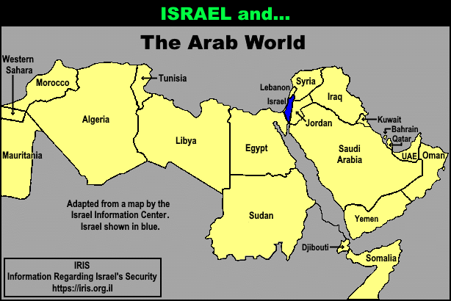

Slide 3
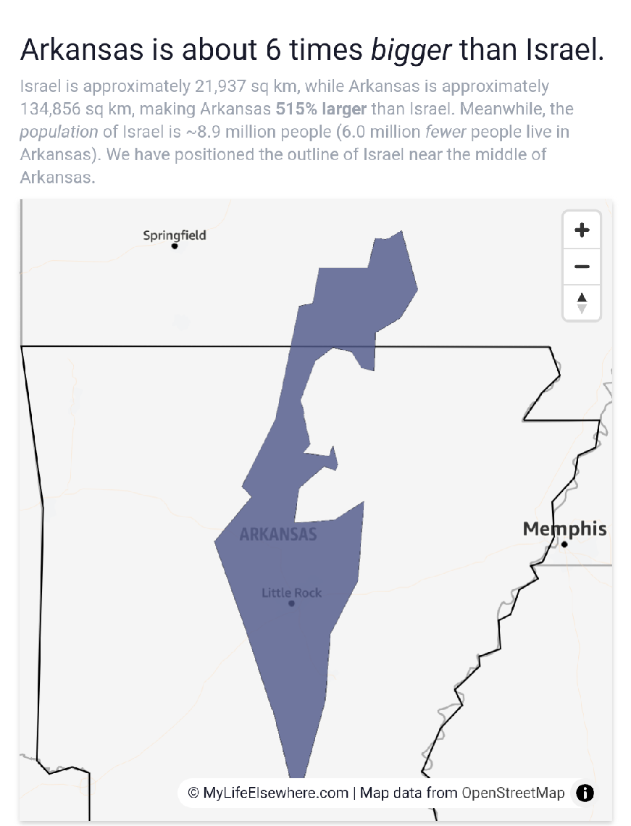

Slide 4
Genesis 12:1-3 Now the Lord had said unto Abram, Get thee out of thy country, and from thy kindred, and from thy father's house, unto a land that I will shew thee:

Slide 5
² And I will make of thee a great nation, and I will bless thee, and make thy name great; and thou shalt be a blessing:

Slide 6
³ And I will bless them that bless thee, and curse him that curseth thee: and in thee shall all families of the earth be blessed.

Slide 7
Genesis 13:1, 4, 14-15, 17
Deuteronomy 32:8-10
Psalm 122:6-9
Zechariah 2:8

Slide 8
A Miraculous Place
God Desires to Bless All Nations Thru the Jews
Israel Is the Most Important Piece of Real Estate On Earth

Slide 9
Israel Is The Geographic Center Of The Earth
Israel Is The Revelation Center Of The Earth
Israel Is The Spiritual Center Of The Earth

Slide 10
Israel Is The Prophecy Center Of The Earth
Israel Is The Storm Center Of The Earth
Israel Is The Peace Center Of The Earth

Slide 11
A Miraculous People
God Promised They Were To Be A Blessing
The Extent Of Their Blessing

Slide 12
A Miraculous Preservation
Satan Desire Was and Is to Eradicate Israel
God Has Never Wavered In His Plan for Israel

Slide 13
A Miraculous Restoration
Satan Desire Was and Is to Eradicate Israel
God Has Never Wavered In His Plan for Israel

