Slide 1

Pastor:
Paul W. Young
Youth Pastor:
Joel P. Young
“…to Him be the glory in the church and in Christ Jesus to all generations forever and ever. Amen.”
~ Ephesians 3:21 ~

Slide 2

Therefore, confess your sins to one another, and pray for one another so that you may be healed. The effective prayer of a righteous man can accomplish much. ~ James 5:16

Slide 3


Summers Missionary Baptist Church
@SummersBaptist
www.summersbaptistchurch.org

Slide 4

Our Weekly Sermon Slides, Welcome Slides, and Bulletins are now available on our website.

Slide 5

We now have a church app…
Download “Churchflare” and search for Summers Baptist Church

Slide 6

Today – Cody & Cheyenne Holliday
Oct 18th – Dakota & Kolby Leming
Oct 25th – Jonathan & Allie Parker
Nov 1st – Garland & Gentry Spinks

Slide 7

We need help in our Nursery ministry! Please see Bro Joel.

Slide 8

Sunday Small Group Bible Studies
Grief Support – 2nd Sunday

Slide 9

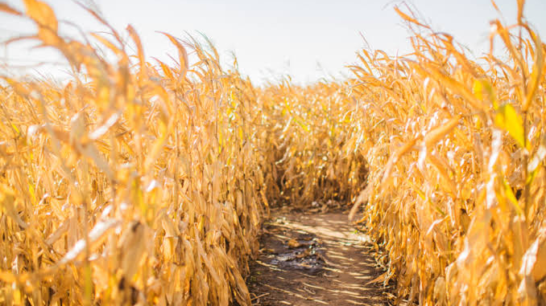
Saturday, October 24th
More details will be announced as the date draws closer

Slide 10

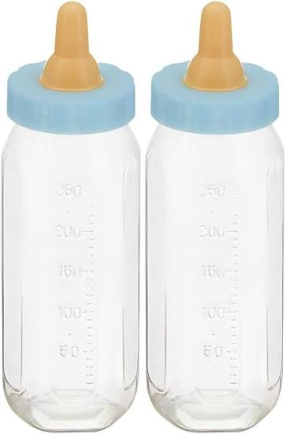
Roxie Salcedo of Choices in Siloam Springs will join us on Sunday, Oct 25th to share about this ministry.

Slide 11

Wednesday, October 28th
We will have AWANA Music and a Lesson, then hand out candy at 7:00

Slide 12

Sunday, November 1st

Slide 13

Meal at 5:30 ($1.00 per person or $5.00 for the family)
AWANA Clubs 6:15-7:30

Slide 14

Join us for Youth Group each Wednesday at 6:30pm

Slide 15

Join us for Wednesday evening adult Bible study at 6:30pm (in person or Facebook Live)

Slide 16


TheMaster’sBuilders are on Facebook!!!

