Slide 1
Pastor:
Paul W. Young
Youth Pastor:
Joel P. Young
“…to Him be the glory in the church and in Christ Jesus to all generations forever and ever. Amen.”
~ Ephesians 3:21 ~

Slide 3
Please send prayer requests to Shirley Spears via email, or in the Summers Prayer Partners Facebook group.
Therefore, confess your sins to one another, and pray for one another so that you may be healed. The effective prayer of a righteous man can accomplish much. ~ James 5:16

Slide 4
Summers Missionary Baptist Church
@SummersBaptist
www.summersbaptistchurch.org

Slide 5
Our Weekly Sermon Slides, Welcome Slides, and Bulletins are now available on our website.

Slide 7
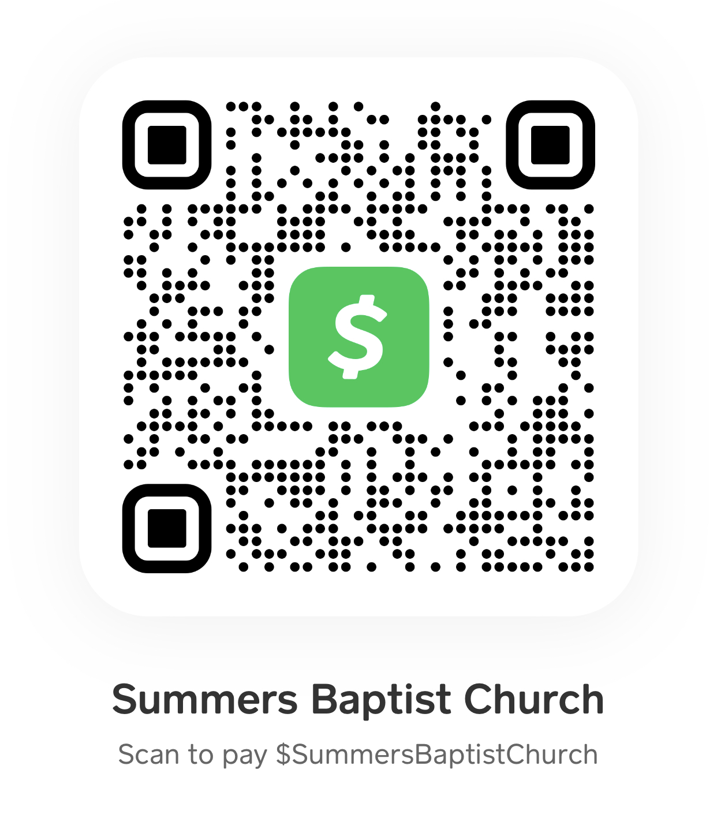
Online Giving
Scan the code here or in the bulletin to submit your tithes and offerings via the Cash App.

Slide 8
We now have a church app…
Download “Churchflare” and search for Summers Baptist Church

Slide 9
Today – Travis & Jessica Thurman
June 4th – Maegan Bailey
June 11th – Jake & Catelyn Hooser
June 18th – Father’s Day

Slide 11
We need help in our Nursery ministry! Please see Bro Joel.

Slide 12
Gideon Sunday
June 4th

Slide 13
Sunday Small Group Bible Studies
Grief Support – 2nd and 4th Sundays at 4:00

Slide 15
Join us for Youth Group each Wednesday at 6:30pm

Slide 16
Join us for Wednesday evening adult Bible study at 6:30pm (in person or Facebook Live)

Slide 17
TheMaster’sBuilders are on Facebook!!!

