Slide 1
Why Is Israel So Important?
Genesis 12:1-3

Slide 2
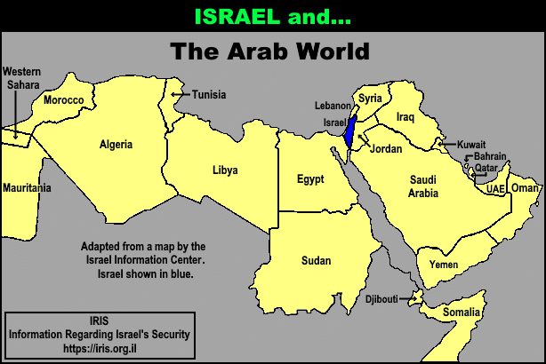

Slide 3
Genesis 12:1-3 Now the Lord had said unto Abram, Get thee out of thy country, and from thy kindred, and from thy father's house, unto a land that I will shew thee:

Slide 4
² And I will make of thee a great nation, and I will bless thee, and make thy name great; and thou shalt be a blessing:

Slide 5
³ And I will bless them that bless thee, and curse him that curseth thee: and in thee shall all families of the earth be blessed.

Slide 6
Genesis 13:1, 4, 14-15, 17
Deuteronomy 32:8-10
Psalm 122:6-9
Zechariah 2:8

Slide 7
A Miraculous Place
God Desires to Bless All Nations Thru Isarel
Israel Is the Most Important Piece of Real Estate On Earth

Slide 8
The Geographic Center Of The Earth
The Revelation Center Of The Earth
The Spiritual Center Of The Earth

Slide 9
Israel Is The Prophecy Center Of The Earth
Israel Is The Storm Center Of The Earth
Israel Is The Peace Center Of The Earth

Slide 10
A Miraculous People
God Promised They Were To Be A Blessing
The Extent Of Their Blessing

Slide 11
A Miraculous Preservation
Satan Desire Was and Is to Eradicate Israel
God Has Never Wavered In His Plan for Israel

Slide 12
A Miraculous Restoration
Their Disbursement
God Has Never Wavered In His Plan for Israel
Israel Is God’s Nation

