Slide 1

Pastor:
Paul W. Young
Youth Pastor:
Joel P. Young
“…to Him be the glory in the church and in Christ Jesus to all generations forever and ever. Amen.”
~ Ephesians 3:21 ~

Slide 2

Therefore, confess your sins to one another, and pray for one another so that you may be healed. The effective prayer of a righteous man can accomplish much. ~ James 5:16

Slide 3


Summers Missionary Baptist Church
@SummersBaptist
www.summersbaptistchurch.org

Slide 4

Our Weekly Sermon Slides, Welcome Slides, and Bulletins are now available on our website.

Slide 5

We now have a church app…
Download “Churchflare” and search for Summers Baptist Church

Slide 6

Today – Garland & Gentry Spinks
Apr 19th – Maegan Bailey
Apr 26th – Brendan & Emilianne Cox
May 3rd – Cody & Cheyenne Holiday

Slide 7

We need help in our Nursery ministry! Please see Bro Joel.

Slide 8
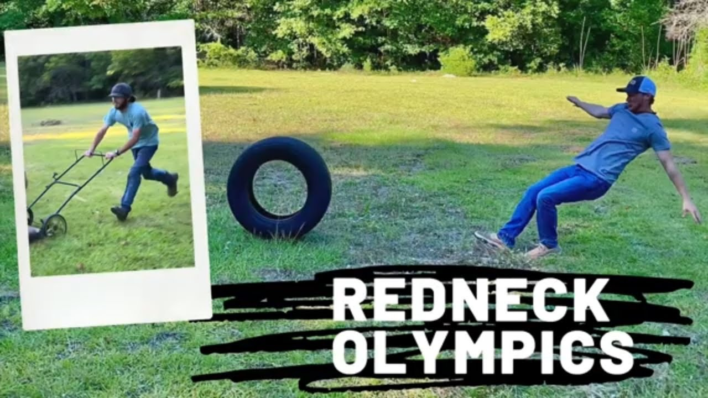
Youth Fellowship
Saturday, April 18th at 7:00pm

Slide 9

Annual Youth Fundraiser
Sunday, April 26th
Bring a smile and your checkbook

Slide 10


Church Camp
June 8 – 12 – Grand Lake Baptist Assembly
Camp Evangelist – Bro Stuart Estes
Cost - $175.00 per camper
T-Shirt Cost - $15.00
Sign up today!

Slide 11

Sunday Small Group Bible Studies
Grief Support – 2nd Sunday

Slide 12

Meal at 5:30 ($1.00 per person or $5.00 for the family)
AWANA Clubs 6:15-7:30

Slide 13

Join us for Youth Group each Wednesday at 6:30pm

Slide 14

Join us for Wednesday evening adult Bible study at 6:30pm (in person or Facebook Live)

Slide 15


TheMaster’sBuilders are on Facebook!!!

