Slide 1

Pastor:
Paul W. Young
Youth Pastor:
Joel P. Young
“…to Him be the glory in the church and in Christ Jesus to all generations forever and ever. Amen.”
~ Ephesians 3:21 ~

Slide 2


Slide 3

Therefore, confess your sins to one another, and pray for one another so that you may be healed. The effective prayer of a righteous man can accomplish much. ~ James 5:16

Slide 4


Summers Missionary Baptist Church
@SummersBaptist
www.summersbaptistchurch.org

Slide 5

Our Weekly Sermon Slides, Welcome Slides, and Bulletins are now available on our website.

Slide 6
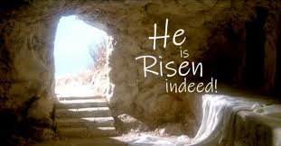

Slide 7

We now have a church app…
Download “Churchflare” and search for Summers Baptist Church

Slide 8

Today – Easter Sunday
Apr 12th – Garland & Gentry Spinks
Apr 19th – Maegan Bailey
Apr 26th – Cody & Cheyenne Holiday

Slide 9

We need help in our Nursery ministry! Please see Bro Joel.

Slide 10
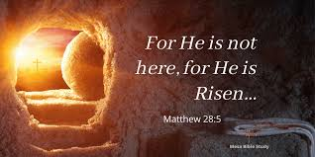

Slide 11

Easter Sunday Schedule
1st Service 8:00
Breakfast 9:00
Sunday School 10:00
2nd Service 11:00

Slide 12

Youth Fellowship
Saturday, April 18th at 7:00pm

Slide 13

Annual Youth Fundraiser
Sunday, April 26th
Bring a smile and your checkbook

Slide 14


Slide 15

Sunday Small Group Bible Studies
Grief Support – 2nd Sunday

Slide 16

Meal at 5:30 ($1.00 per person or $5.00 for the family)
AWANA Clubs 6:15-7:30

Slide 17

Join us for Youth Group each Wednesday at 6:30pm

Slide 18


Slide 19

Join us for Wednesday evening adult Bible study at 6:30pm (in person or Facebook Live)

Slide 20


TheMaster’sBuilders are on Facebook!!!

